Slide 1
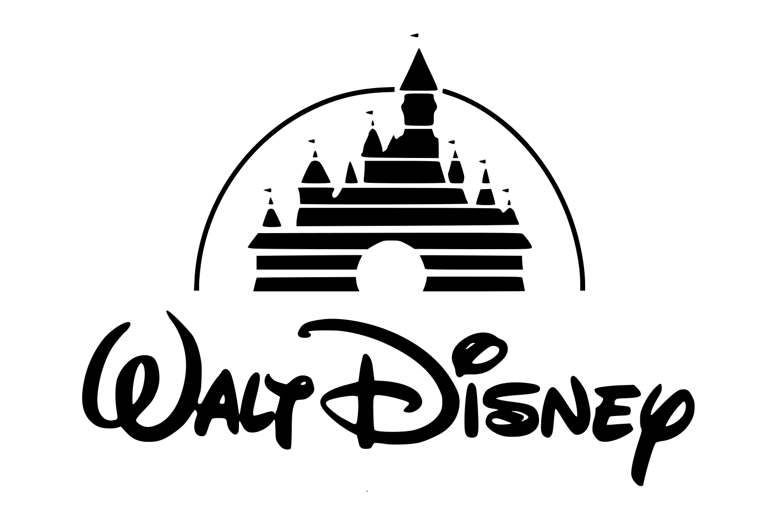
Disneyland Customer Review Analysis
Team Member:
Miranda Zhou, Rae Wang, Eva Yang, Keren Li, Xue Gao

Slide 2
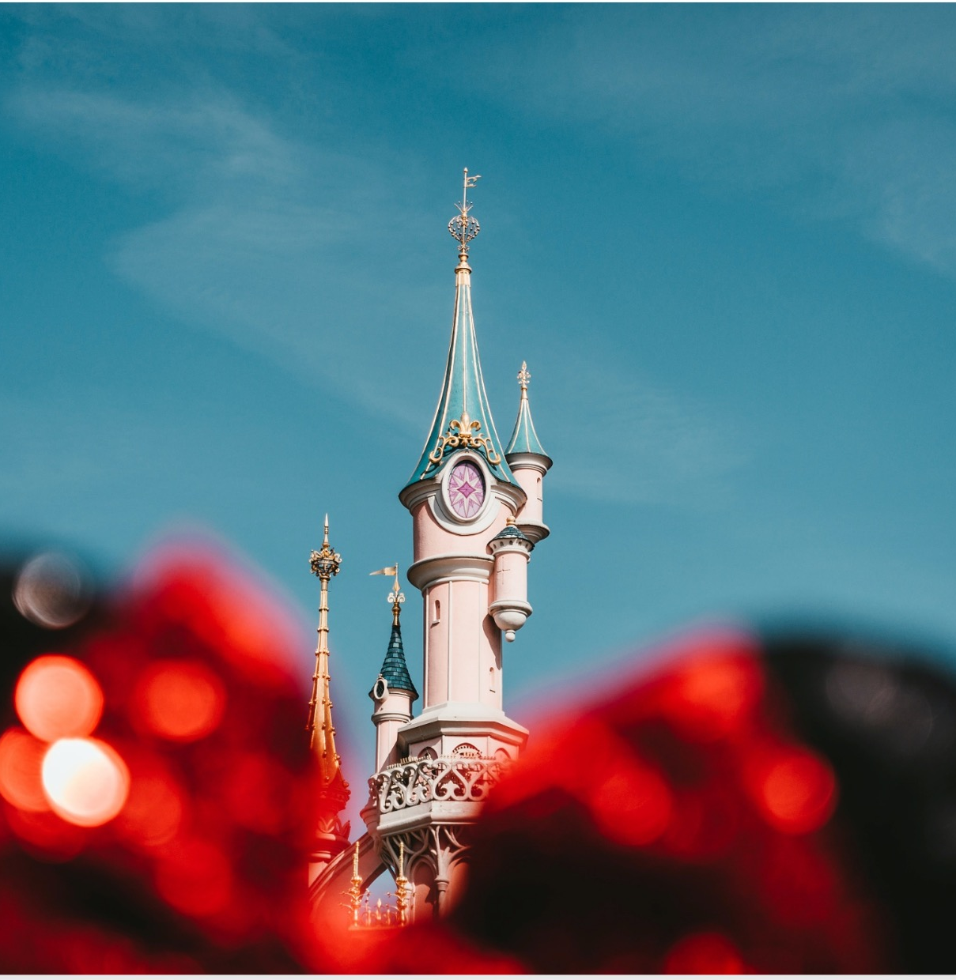
Agenda
Project Overview
Data Cleaning
Topic modeling
Sentiment prediction
Recommendations
Conclusion & Next Step

Slide 3
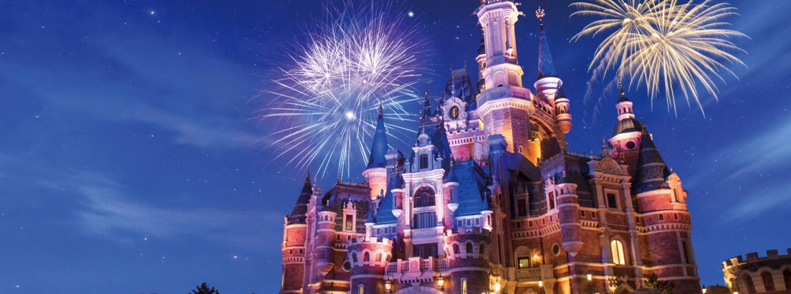
Overview

Slide 4
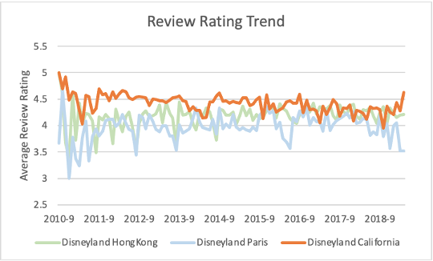
Project Overview
There are 12 different Disney Parks all over the world in 6 different resorts.
From 2010 to 2019, average customer ratings for Disneyland California has been trending downwards while Disneyland HongKong and Disneyland Paris have increasing review rating trends.
Our project analyzes 42656 customer reviews to understand customer feedback and sentiment for Disneyland to provide recommendations for improvement.

Slide 5
Our Approach
We chose Disneyland because
Disneyland Park is a land of magic where children and the young can find their dreams come true.
As Walt Disney said “Disneyland will never be completed. It will continue to grow and improve as long as there is imagination left in the world.”
We gained informative insights through
Topic modeling to find out abstract topics which might serve as potential recommendations.
Sentiment prediction to classify customer reviews into positive and negative groups, helping decision makers evaluate Disneyland’s operational efficiency.

Slide 6
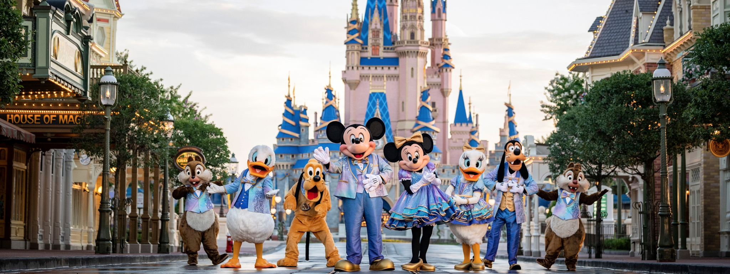
Data Cleaning & EDA

Slide 7
Data cleaning
Data overview
42,656 reviews of 3 Disneyland branches - Paris, California, and Hong Kong
Rating ranging from 1(unsatisfied) to 5(satisfied)
Review Text made by visitors
Cleaning steps
Remove malformed characters
Reduce variations of frequently used words
Remove stopwords
Lemmatization

Slide 8
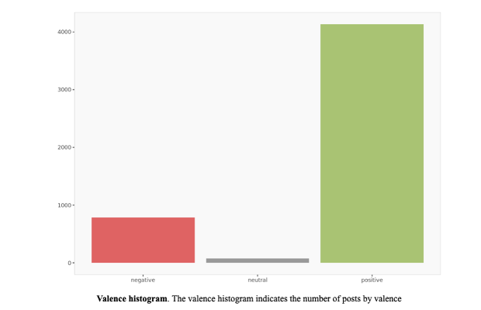
Data Distribution
Rating Distribution
16% Negative - Rating <3
2% Neutral - Rating = 3
83% Positive - Rating >3

Slide 9
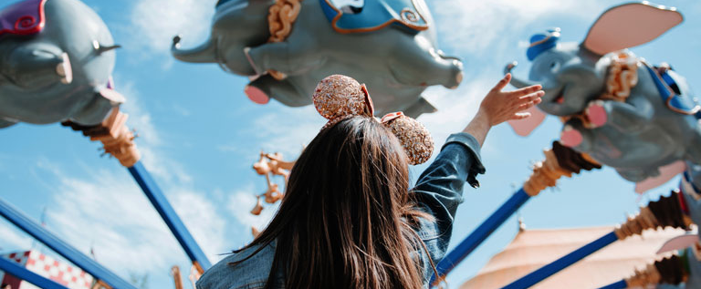
Topic Modeling

Slide 10
Topic Modeling Overview
Methodology
Assumptions
Output Interpretation
Latent Dirichlet Allocation Approach for Modeling
Choose number of topics to be 3
Negative Reviews: Rating <= 3
Positive Reviews: Rating > 3
Topic varies by Disneyland branches
Word Clouds: Visualize positive/negative keywords
pyLDAvis: Visualize relations and compositions of each topic

Slide 11
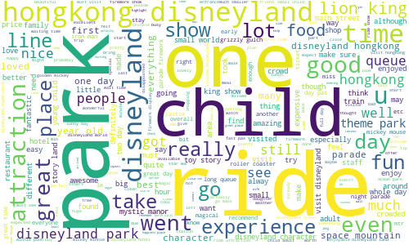
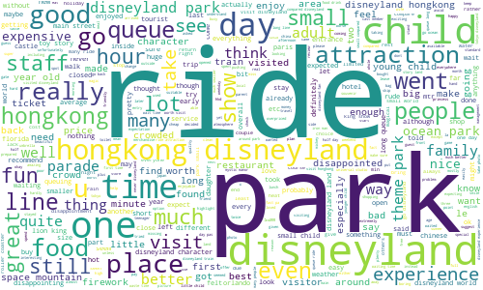
Word Cloud - Disneyland Hong Kong
Positive Reviews
Negative Reviews

Slide 12
Topic Summary - Disneyland Hong Kong
Good Events
Visitors feel good about food, firework, and parade.
Fun Rides
Visitors enjoy rides and activities such as mountain space, and jungle cruise.
Favorable Characters
Visitors praise Disney characters such as Mickey, King Lion and princess.
#1
#2
#3
From Positive Reviews
Bad Experience Quality
Visitors complain about rides, food, long queue and waiting time.
Terrible Customer Service
Visitors gave negative reviews on rude service and staff, and security issues.
Mediocre Rides
Visitors’ negative reviews relates to rides/activities such as Jungle Cruise, Peter Pan.
#1
#2
#3
From Negative Reviews

Slide 13
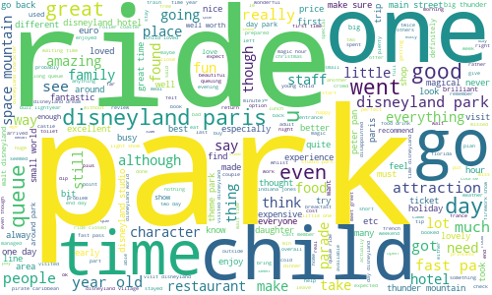
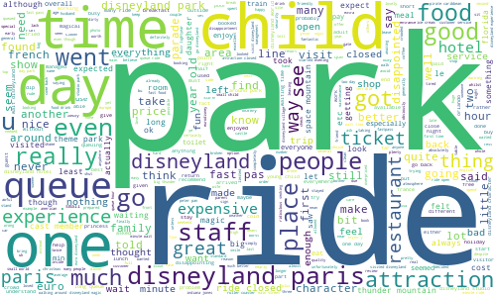
Word Cloud - Disneyland Paris
Positive Reviews
Negative Reviews

Slide 14
Topic Summary - Disneyland Paris
Good Kids Experience
Visitors give positive reviews on rides, parade and shows. Children love it!
FastPass
Visitors feel good about fastpass and queue time.
Hotel Meals
Visitors’ positive reviews relates to hotel and meals (breakfast, lunch and dinner).
#1
#2
#3
From Positive Reviews
Long Queue
Visitors give negative reviews on time and queue. Maybe they were the ones who didn’t purchase FastPass.
Terrible Customer Service
Visitors give negative reviews on rude services and staff, bus, and room.
Bad Hotel Infrastructure
Visitors complain about hotels, especially room condition (bed/towel).
#1
#2
#3
From Negative Reviews

Slide 15
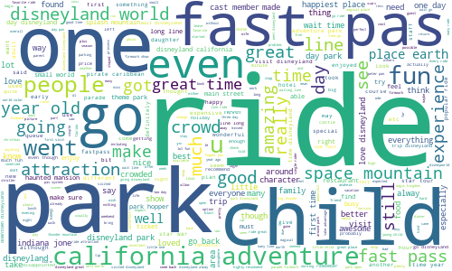
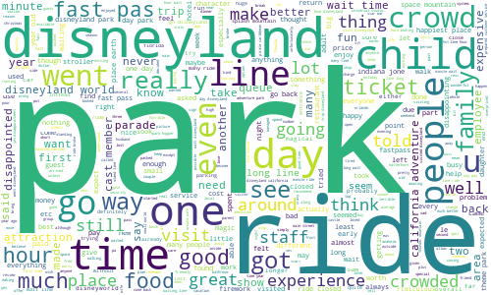
Topic Summary - Disneyland California
Positive Reviews
Negative Reviews

Slide 16
Topic Summary - Disneyland California
Family-friendly
Visitors feel good about children and family experience.
FastPass
Visitors give positive reviews on FastPass and waiting line.
Fun Rides
Visitors love rides/adventures such as space mountain, Caribbean Pirate, Indiana Jones.
#1
#2
#3
From Positive Reviews
Long Queue
Visitors who didn’t purchase FastPass complaint about long line and wait time, and closed rides.
Park Capacity
Visitors give negative reviews on crowdedness, staff and line.
Special Service
Visitors complain about guest relations,wheelchair services, and ticket policy related to refund.
#1
#2
#3
From Negative Reviews

Slide 17
Summary of Insights
Different branches have unique values and issues.
Hong Kong distinguishes itself by disney characters.
Paris visitors mention hotels and restaurants a lot both positively and negatively.
California branch stands out by its adventures and rides, but may have issues on guest services and ticket policy.
Visitors may have opposite attitudes and perspectives on the same thing.
Fastpass holders may praise the short waiting time and queue line; however, people without fastpass may complain about the long line and waiting time.
Hotel guests who pay for premium rooms may give positive reviews on the hotel and meals; however, people who pay for economy rooms may complain about the hotel and food.

Slide 18
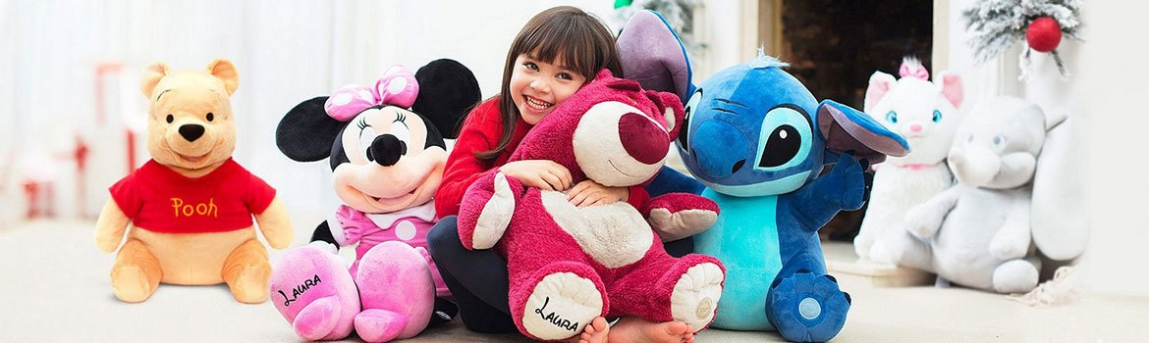
Sentiment Prediction

Slide 19
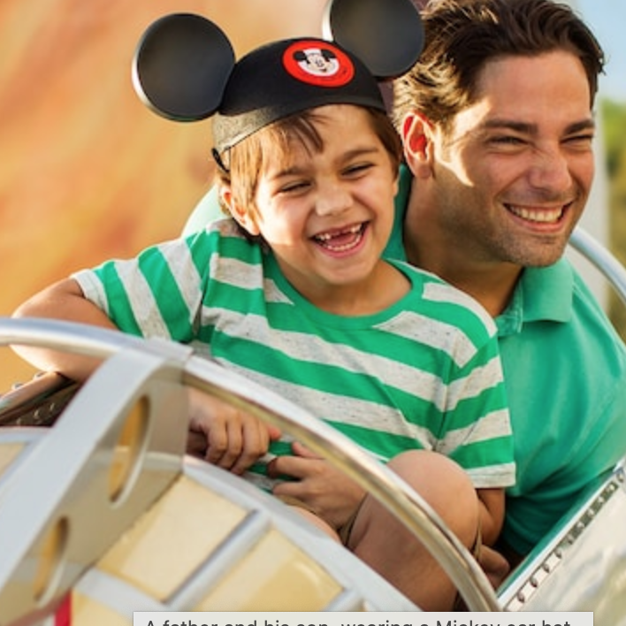
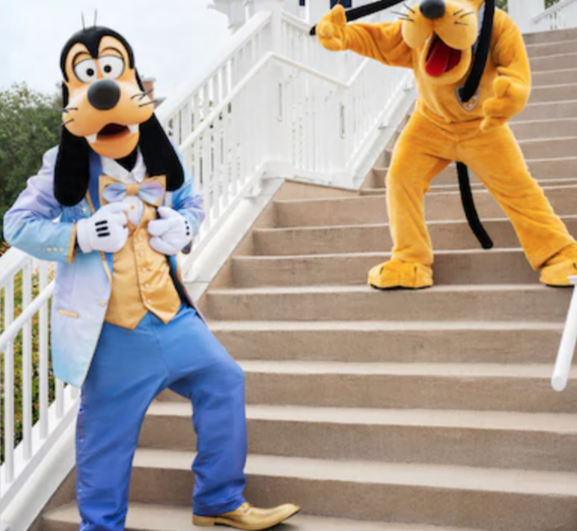
Objective
Quantify the text review into numeric rating can effectively help users evaluate the Disney’s performance.
Predicting Review Ratings
Task
Prediction of rating of a review given based on review text. To classify review into positive or negative label.

Slide 20
Summary of Insights
Depend Variable(y):
Binary variable
1 for positive ( Rating > 3 )
0 for negative (Rating <= 3 )
Independent Variable(X):
Review_Text:
N-gram level TF-IDF
Train and Test Random split:
Train dataset size: 67% of all reviews
Test dataset size: 33% of all reviews
Notes:
Additional Facts:
Desktop User Web Revenue: $886,243,453, Unique User: 1,277,345
Mobile User Web Revenue: $1,037,527,919, Unique User: 2,337,248

Slide 21
Model Performance
Baseline Model
Champion Model:
Logistic Regression
Logistic Regression
Accuracy_score: 88.6%
Model #1
Model #2
Model #3
Navis_bayes. Multinomial NB
Accuracy_score: 86.7%
Random Forest Classifier
Accuracy_score: 84.4%
XGB classifier (Countvectorizer)
Accuracy_score : 86.9%

Slide 22

Recommendations

Slide 23
Recommendations
Establish High Quality Services
Improve Customer Service
Conduct surveys to understand customer food preference and provide better food options
Improve hotel infrastructure
Better accessibility for people with special needs, such as more wheelchairs for people with disability
Quarterly employee training on customer engagement etiquette
Enhance Waiting Experience
Create Social Media Virality
Incorporate AR engagements to keep people entertained while waiting in line
Limit daily park capacity for better visitor experience
Promote Favorite Disneyland Activities
Best Reaction to Disneyland Rides Challenge on TikTok and Instagram

Slide 24

Conclusion & Next Step

Slide 25
Conclusion & Next Step
1
2
3
4
Customer Focus
Branch Uniqueness
Sentiment Prediction
Further Research
Experience related to rides, dinning, and waiting time
Satisfaction towards service provided by park stuff
Interests in Disney characters
Each branch stands out with its unique values
All of them should maintain favorable advantage, while improve in weakness
Customer reviews can reflect well about their attitudes and opinions
Each branch should pay attention to reviews gathered across different platforms
Given more time, we could try to predict specific rating with more detailed sentiment focus

Slide 26
Thank you!

Slide 27
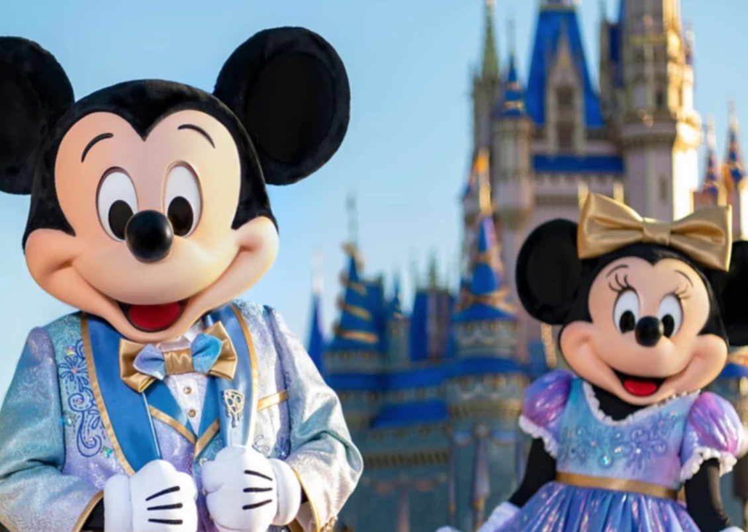
Appendix
Additional Supportive Information
Appendix

Slide 28
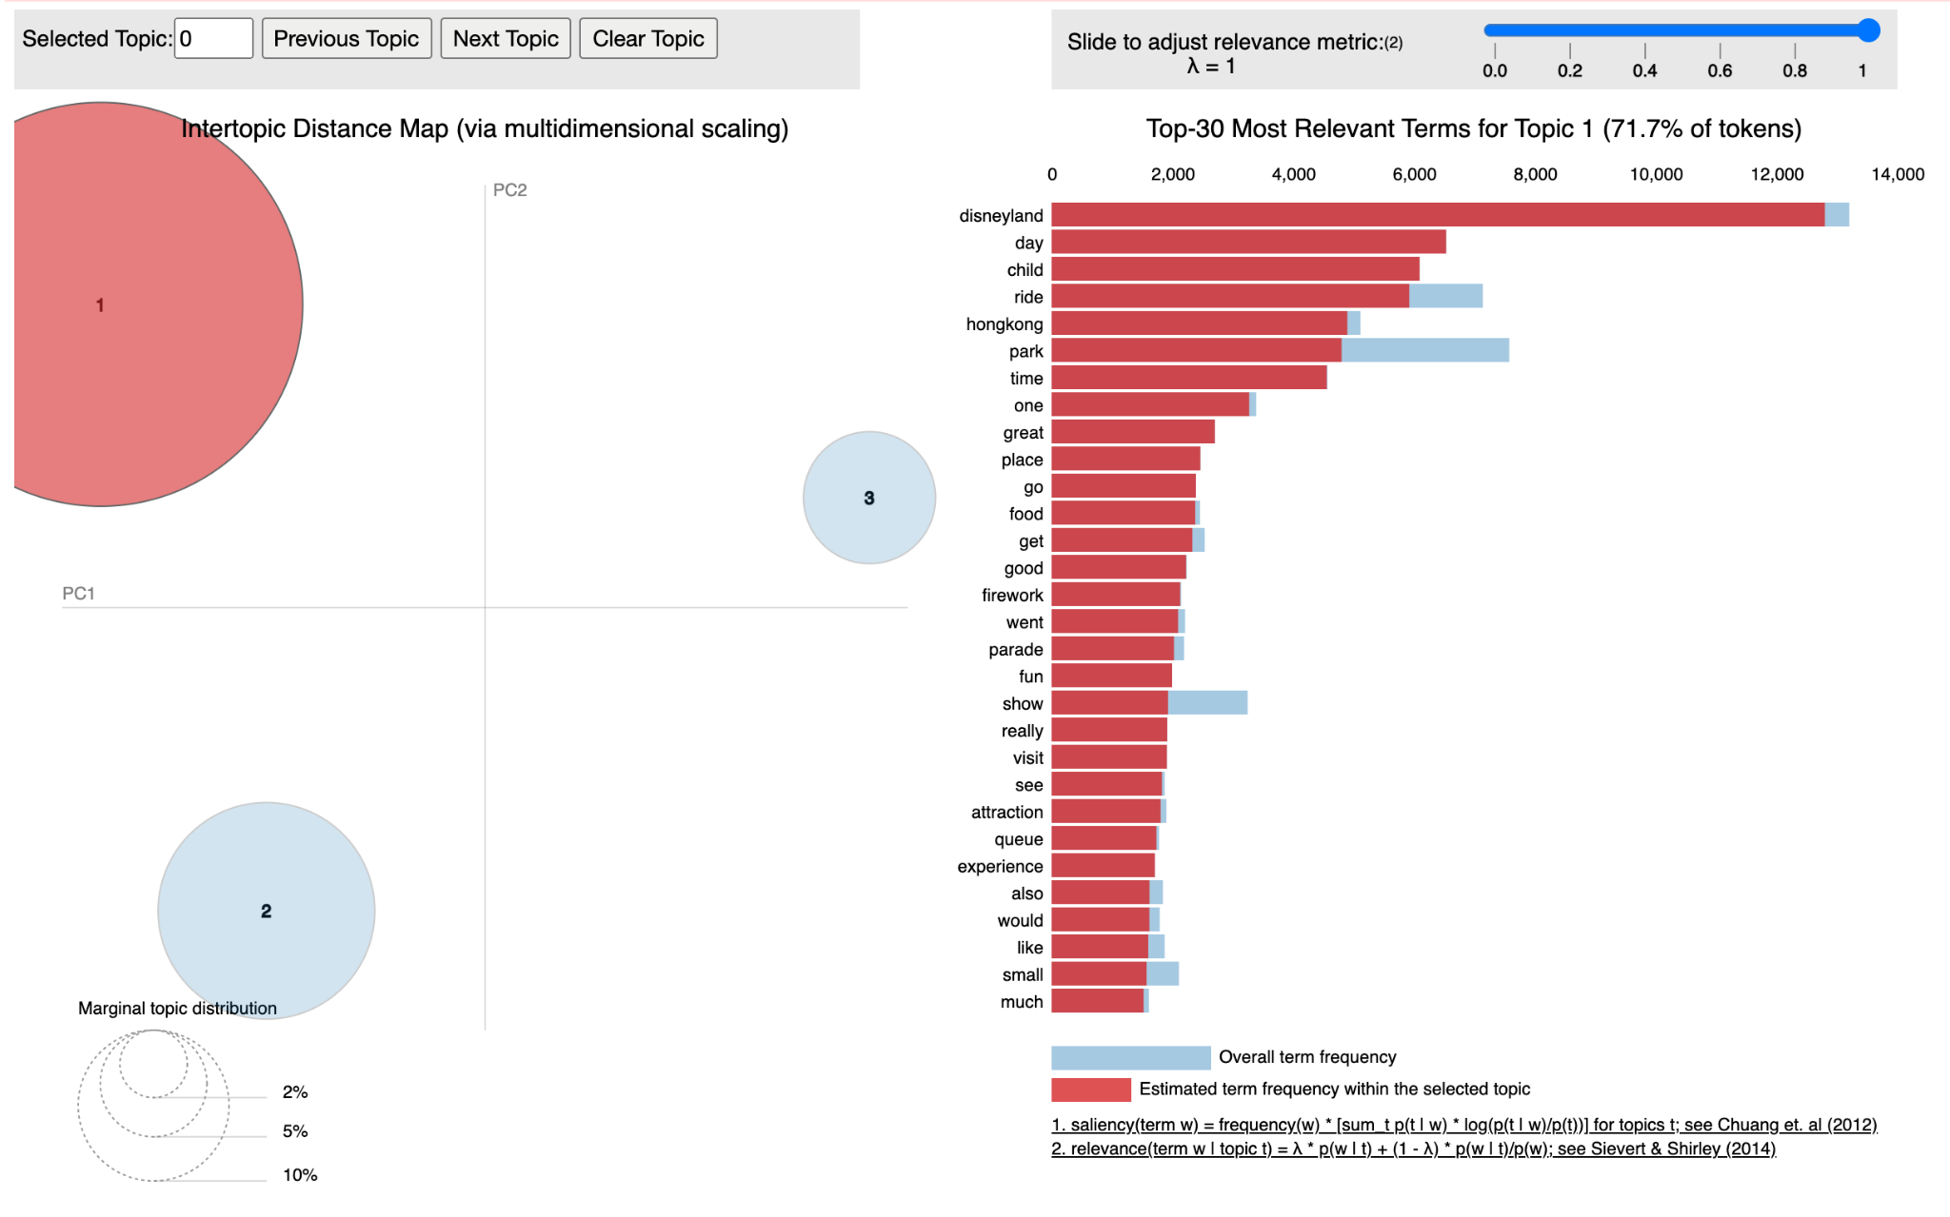
Disneyland Hong Kong Negative Reviews - Topic Modeling
Topic 1

Slide 29
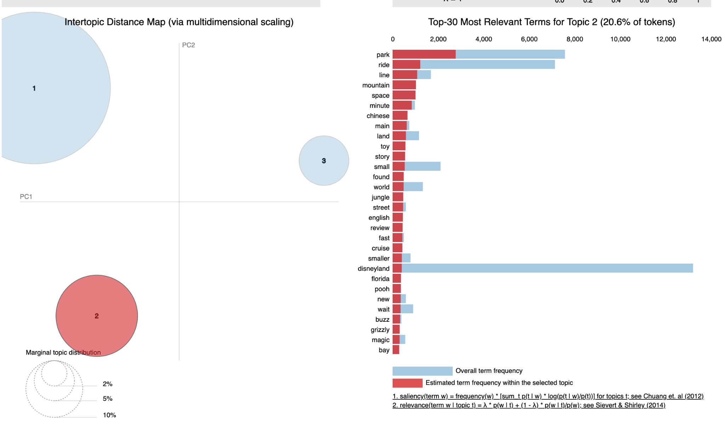
Disneyland Hong Kong Negative Reviews - Topic Modeling
Topic 2

Slide 30
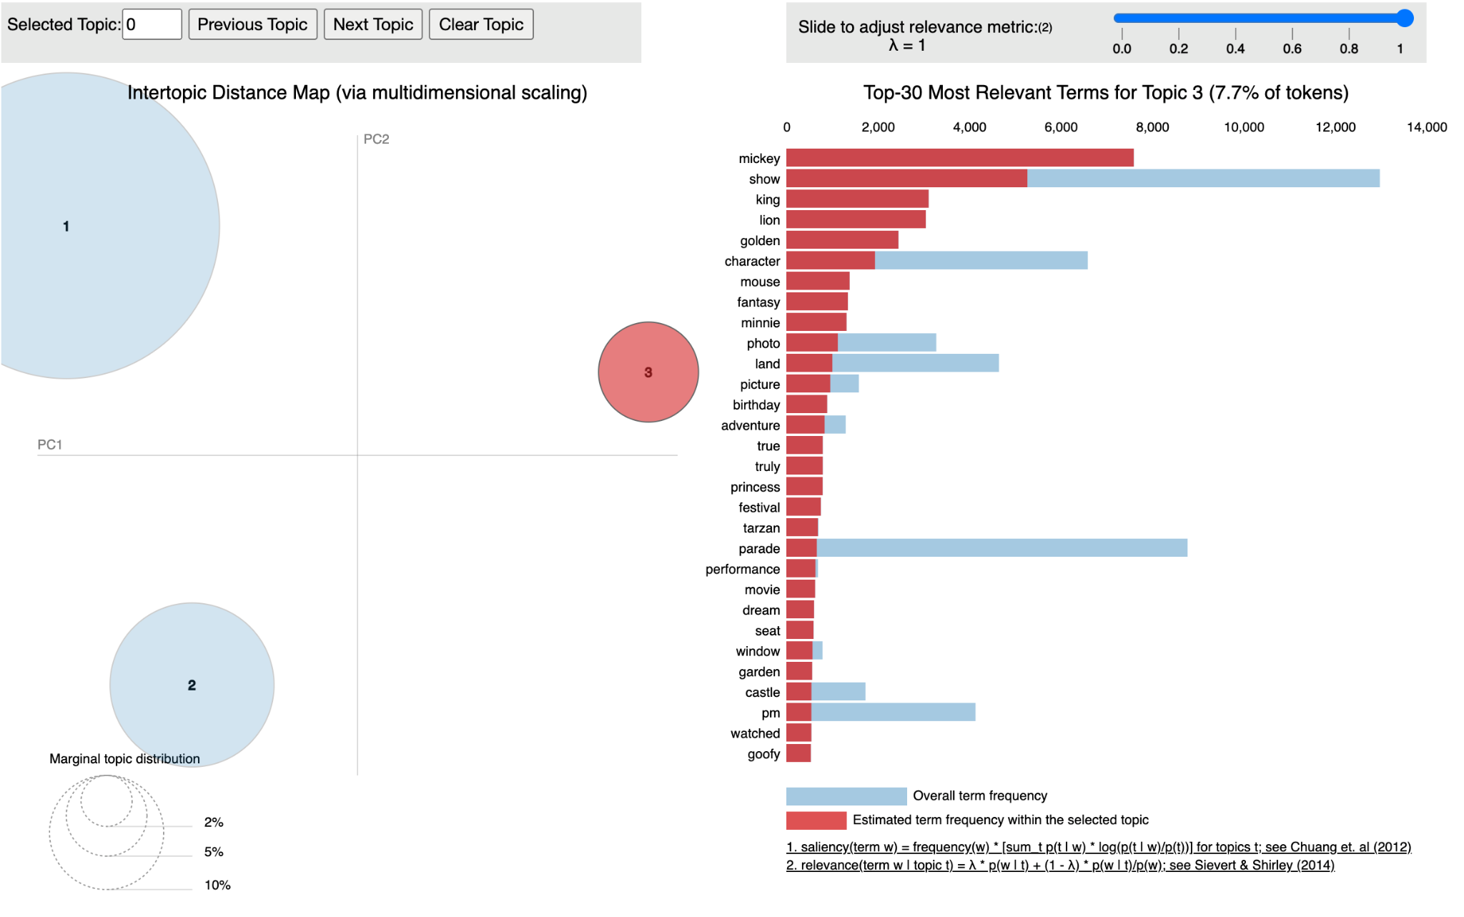
Disneyland Hong Kong Negative Reviews - Topic Modeling
Topic 3

Slide 31
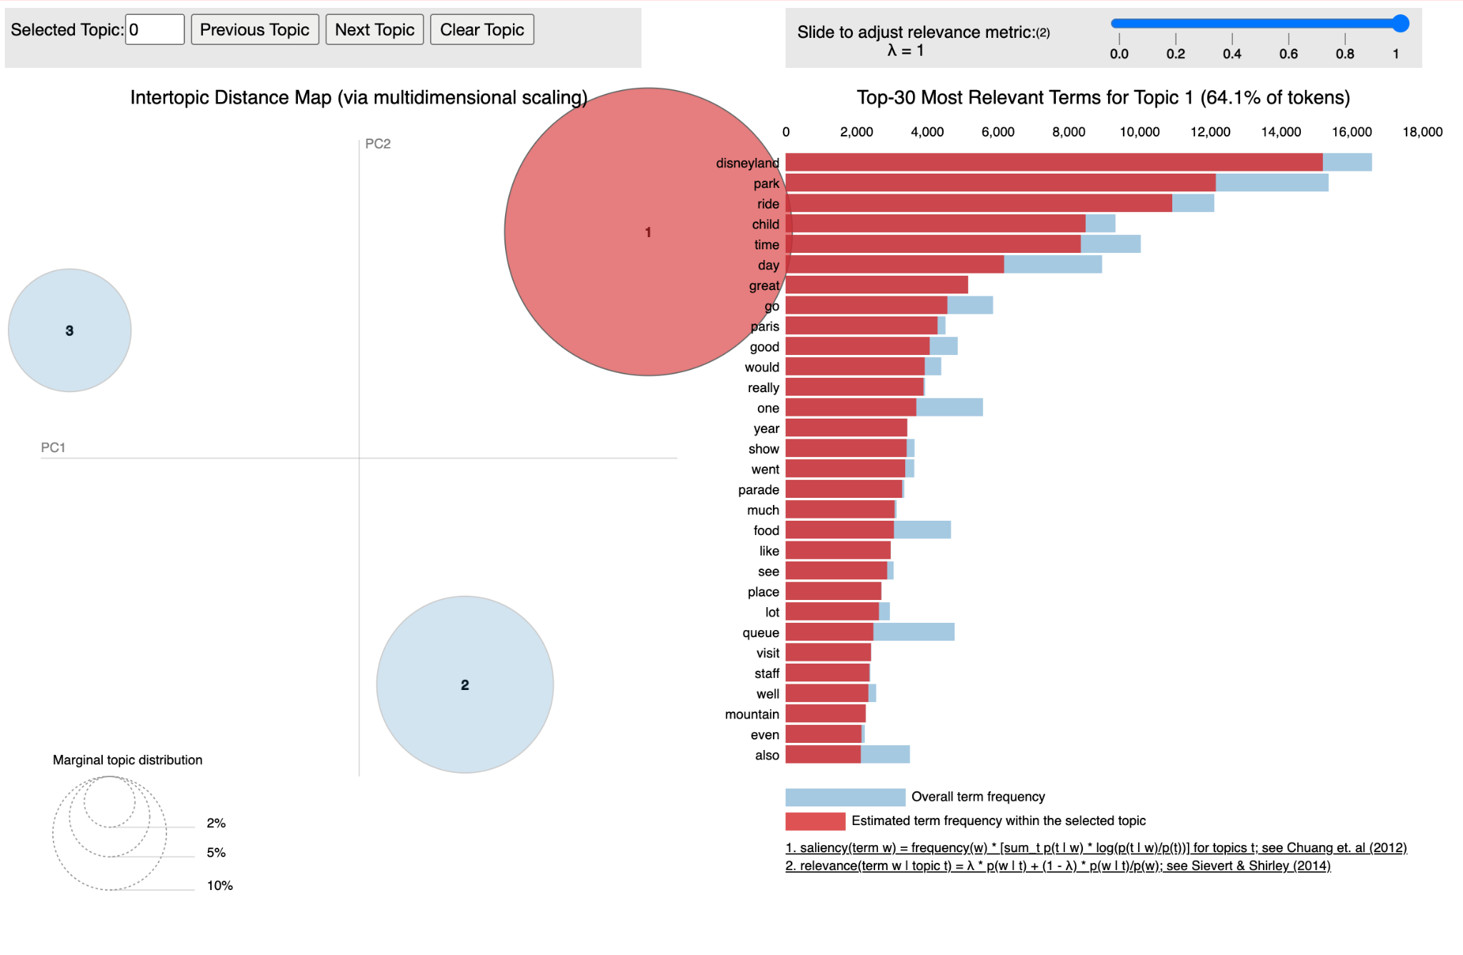
Disneyland Paris Negative Reviews - Topic Modeling
Topic 1

Slide 32
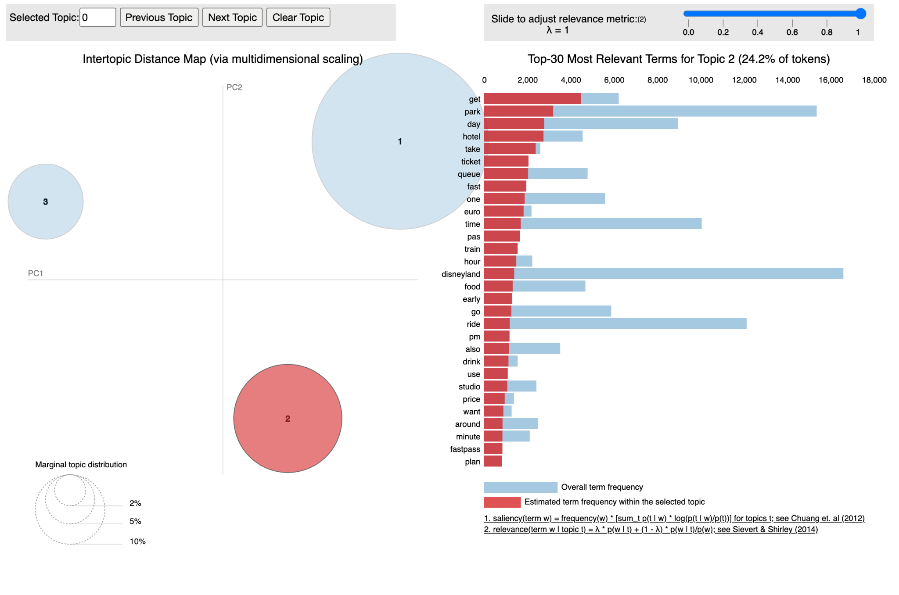
Disneyland Paris Negative Reviews - Topic Modeling
Topic 2

Slide 33
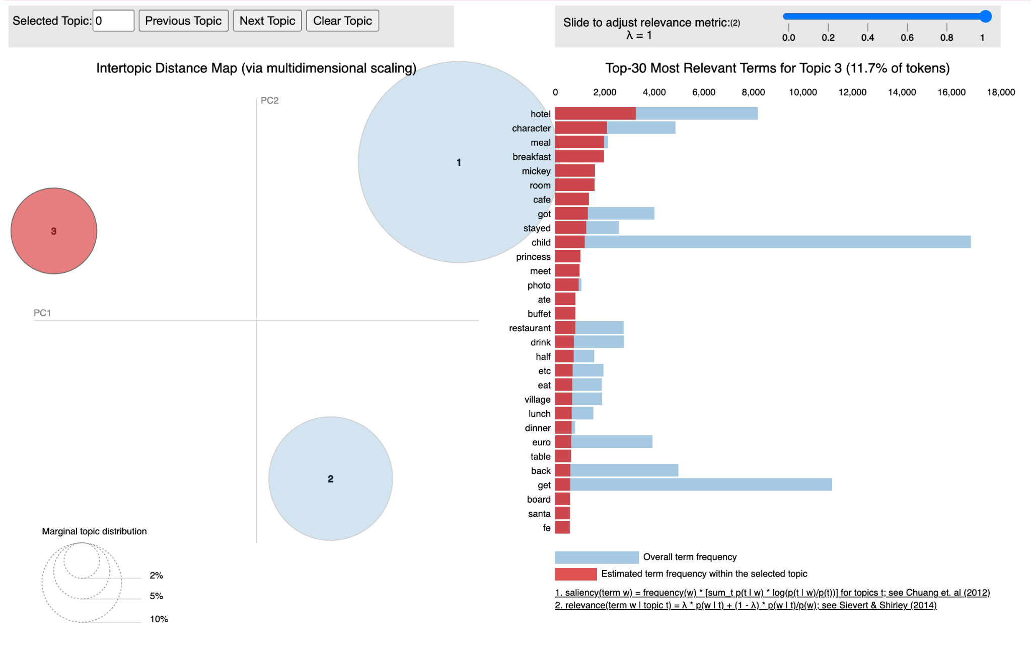
Disneyland Paris Negative Reviews - Topic Modeling
Topic 3

Slide 34
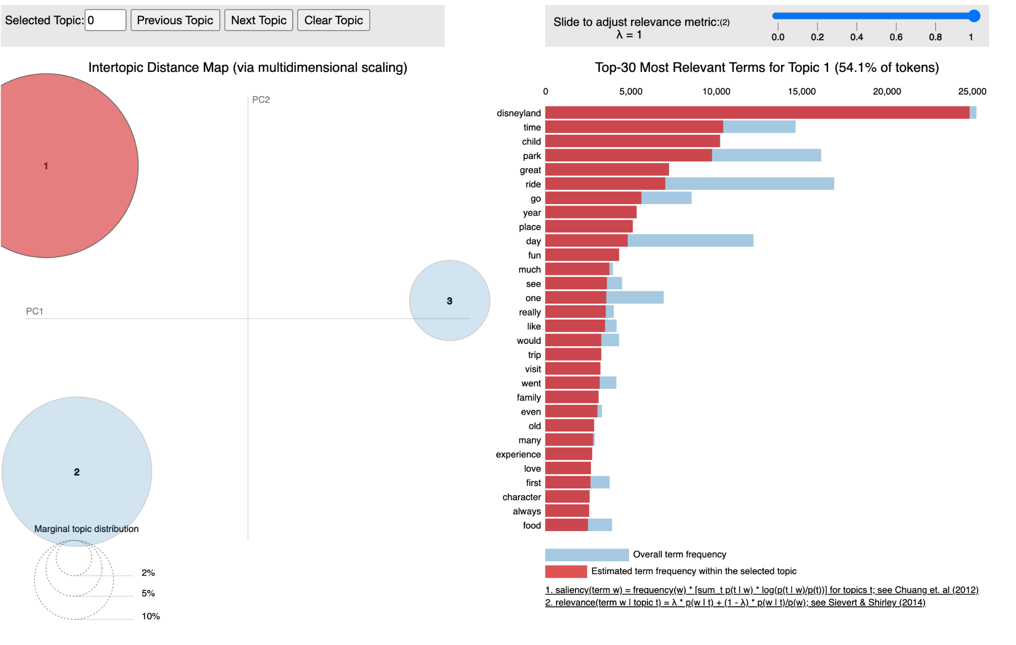
Disneyland California Negative Reviews - Topic Modeling
Topic 1

Slide 35
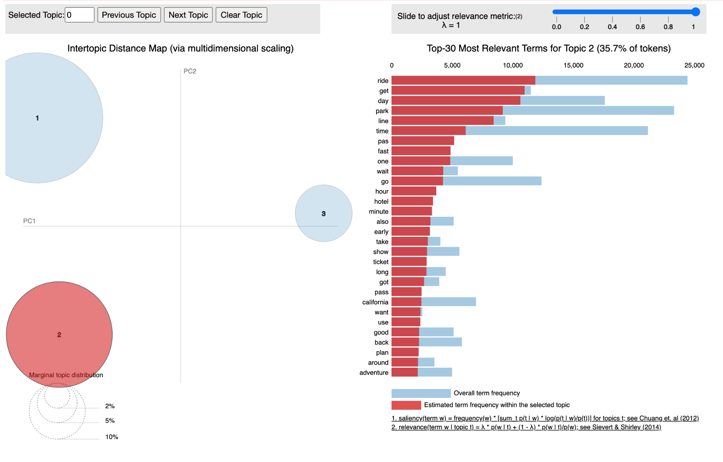
Disneyland California Negative Reviews - Topic Modeling
Topic 2

Slide 36
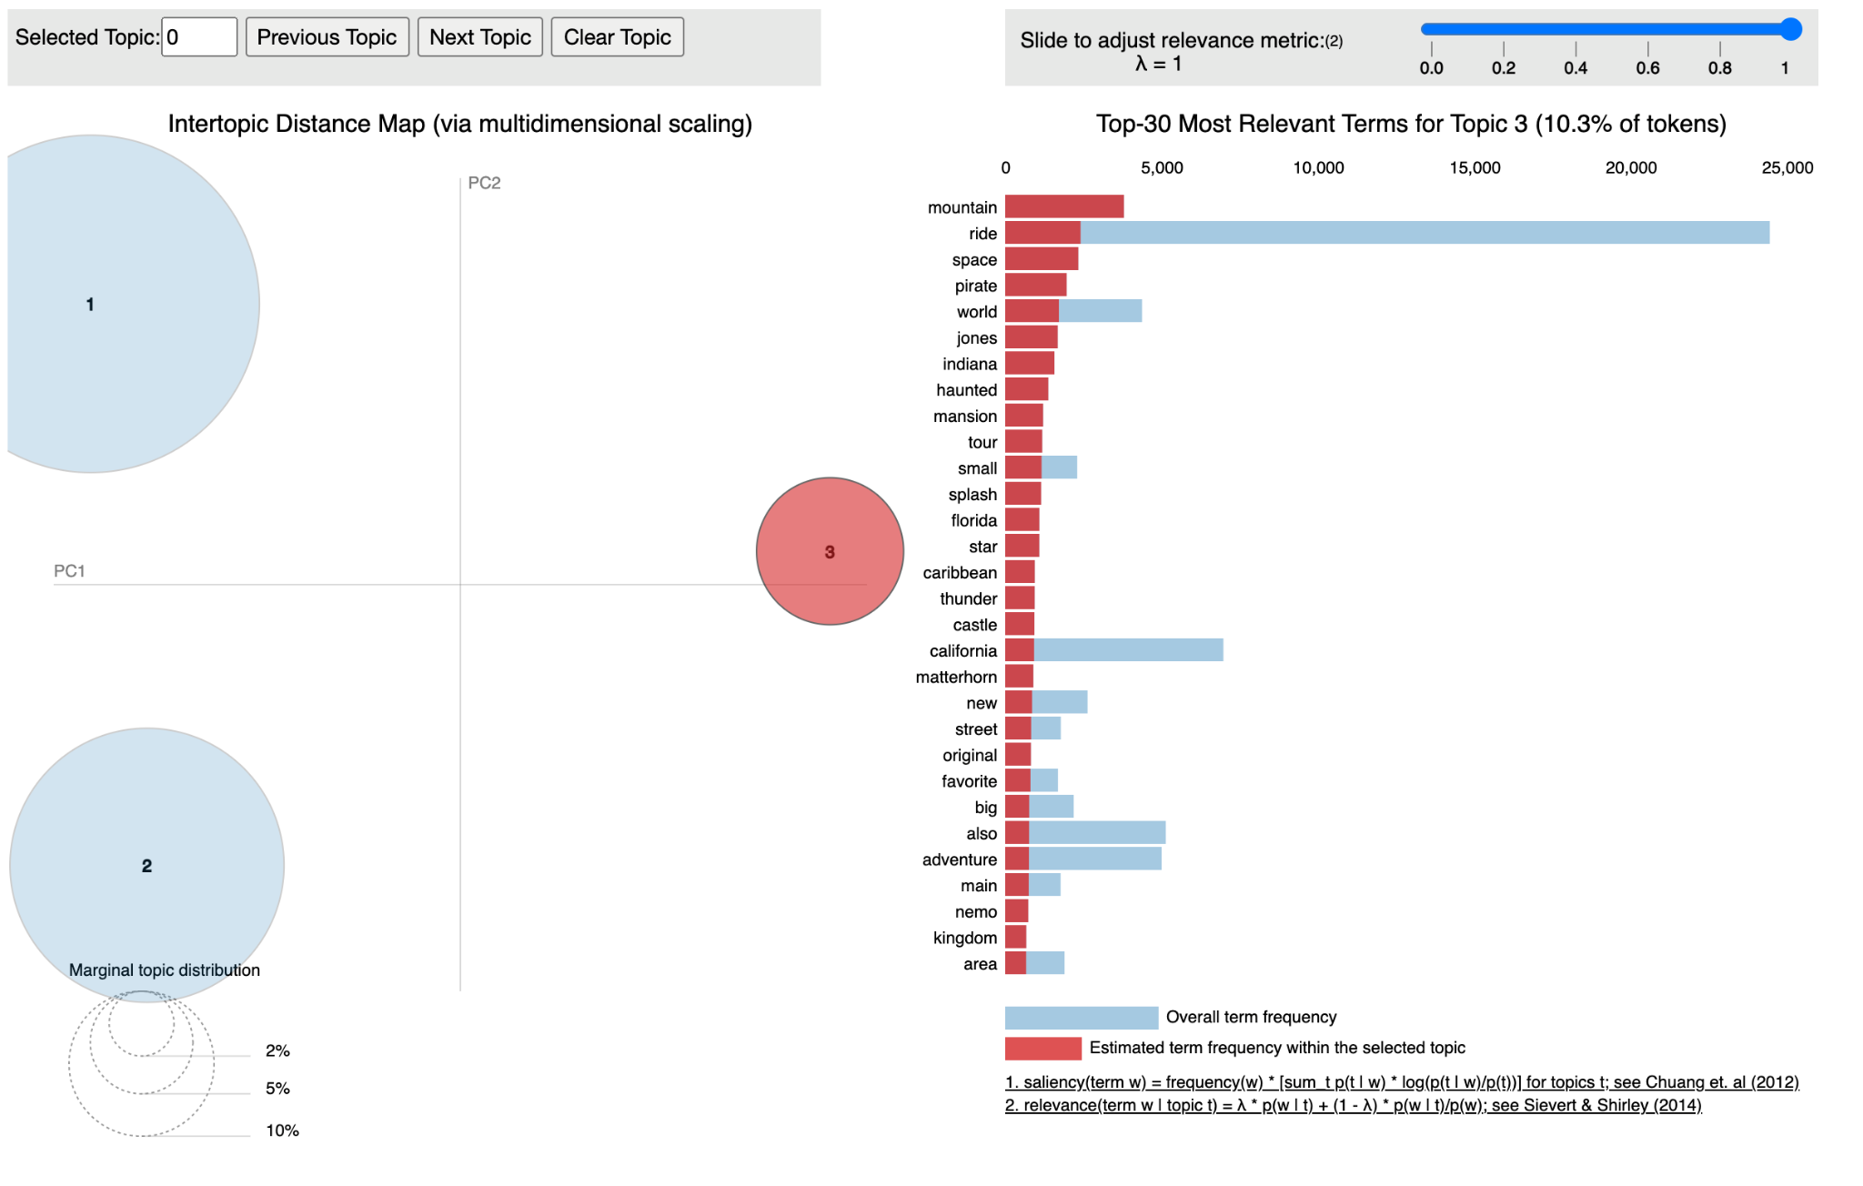
Disneyland California Negative Reviews - Topic Modeling
Topic 3

